Slide 1
The Pennsylvania Horticultural Society motivates people to improve the quality of life and create a sense of community through horticulture.
Notes:
Thank you for attending this webinar/training.
PHS has developed this series of six training modules, through grant funding from EPA Region III, in order to help clarify appropriate maintenance techniques for Green Stormwater Infrastructure practices (GSI). It is our hope that the information included here will be helpful for anyone who is learning about SBMPs or is training others about properly maintaining the practices.

Slide 2
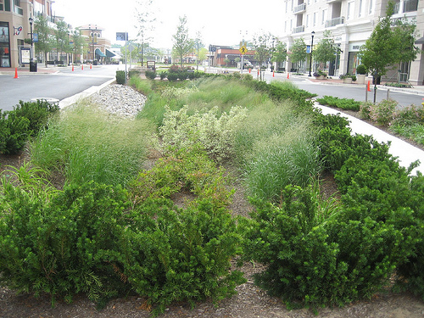
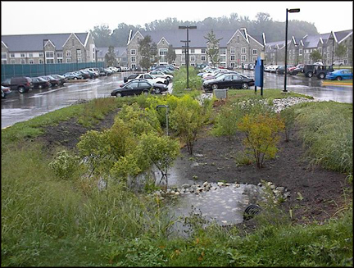
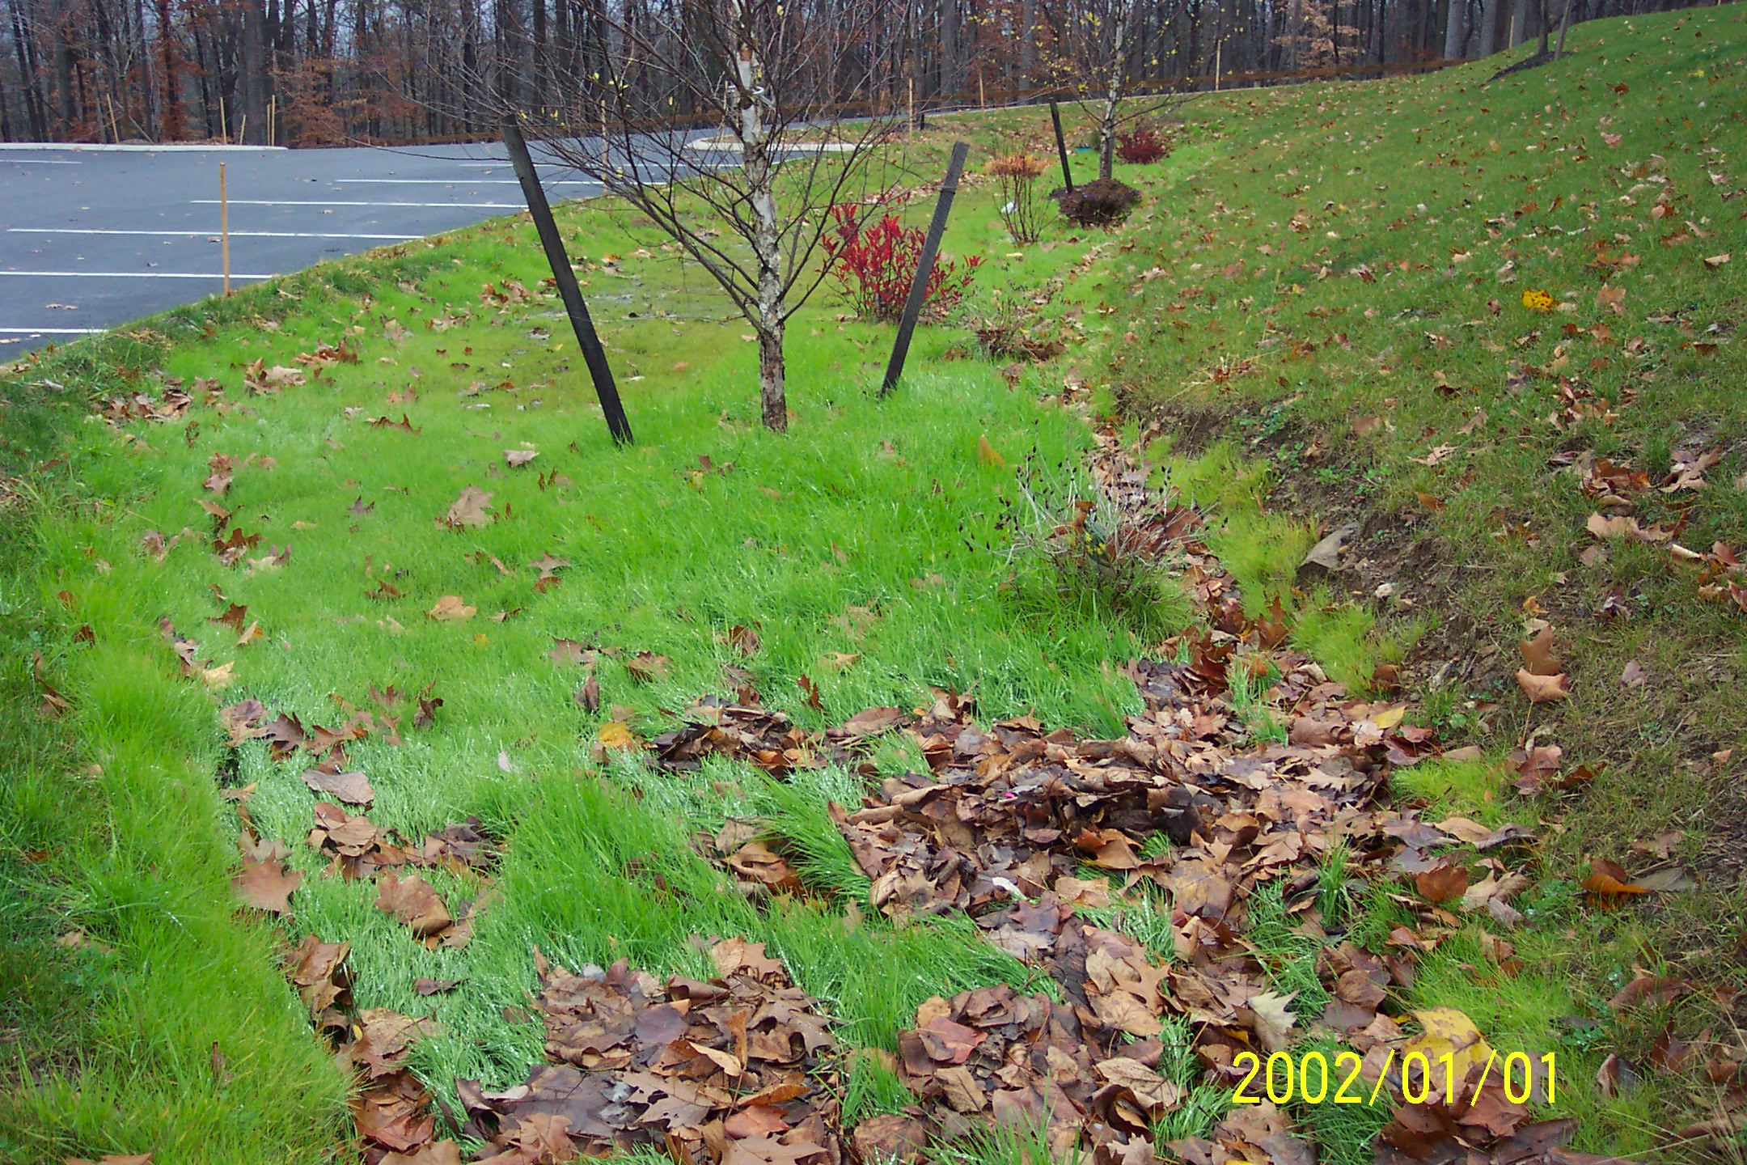
Maintaining Green Stormwater Infrastructure (GSI) Systems
Sustaining green infrastructure through proper landscape management
Introduction to Watersheds
Emma Melvin
PHS Regional Project Manager
Notes:
The materials in the training sessions include the following:
*A glossary of terms used in describing and discussing GSI practices (also referred to as “systems”)
*A checklist of activities to be considered when evaluating the condition of the BMPs.
Fundamental to each training module is an explanation of the design of the systems and pertinent information for maintaining them.

Slide 3
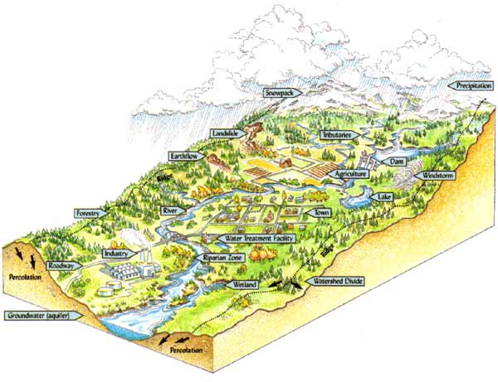
Understanding the Watershed
Notes:
We begin with a review of watershed dynamics.
What is a watershed?
To understand why green stormwater management is so important and why it is being used throughout our developed landscapes, one needs to understand how water moves over the land, and how land cover effects the impact of this water on streams, lakes and other water bodies. Let’s start with defining a watershed: the area of land that drains into a particular body of water. A watershed can be small, like the land that drains into a puddle. Or it can be large, like the land that drains into the Atlantic Ocean. Everyone lives in a watershed, even if you don’t see the stream or river into which your watershed is draining. The watershed contains everything that covers the land, including forests, buildings, roads, lawns, and storm drains and culverts.
What is the natural cover of PA watersheds? Over 90% of Pennsylvania was once covered by forests. Water bodies such as streams and rivers were shaped by the flow of water entering the stream channels via ground and surface water travelling through these forests.
How do the forests manage rain water? In forested land areas, rain is intercepted at multiple levels. First, in the canopy of leaves, much of this water is evaporated back into the air. As the rain water travels down the tree trunks, some becomes absorbed by the bark, then travels down the trunk to be absorbed in the leaf litter on the forest floor , with the remainder soaking into the ground. Very little water runs over the surface of the forest floor into water bodies. Most enters the water body through subsurface flow or ground water.
How has watershed land cover changed? Human beings change the natural land cover by clearing the trees, putting up buildings, creating roads, diverting water and stream flow (sometimes leading underground into pipes) and replacing native plants with cultivated plants like lawn. Each of these changes impacts the flow of water through the watershed into the receiving water body.
How have those changes impacted the path of rain to rivers? Through every step of development, we change the way the water flows to the river. As we remove trees, we reduce the amount of water captured in the leaves and evaporated back into the air, thus more water reaches the ground and increases the volume that flows over the surface. Without the leaves to lessen the energy of rain drops, the soil is no longer protected and we have more soil erosion as the water hits the ground. When we construct buildings and roads, this reduces the amount of pervious surface that can infiltrate the water. The surface water picks up pollutants from our built environment – lawn chemicals, leakage from cars, litter and other materials that can adversely affect our aquatic environment.

Slide 4
Understanding the Urban Watershed Connections
Notes:
Here is a short video illustrating how water moves through a developed system.

Slide 5
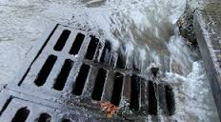
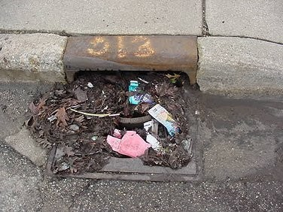
Grey Stormwater Infrastructure
Stormwater Drains
Notes:
What connects development to streams? In developed areas, we attempt to drain water off our built environment as quickly as possible. To do this, we have changed the slope of the land, paved channels and designed all our buildings, roads and sidewalks to move water quickly and efficiently away, into a conveyance system. There are usually two kinds of conveyance systems: 1) an open system made up of swales and pervious surfaces; and 2) a closed system (also called grey storm water infrastructure) consisting of storm drains, culverts and outfalls that are connected directly to a local water body.
How does this change the management of water in a watershed? These systems increase the volume and the speed at which the storm water reaches the stream. Large quantities of fast-moving water have more force to erode the stream beds and banks, with the capacity to pick up and hold more sediment. In an undisturbed area, the stream’s water level slowly rises and falls during a rain event. But in a built environment, the water level rises quickly to extremely high levels and then falls quickly. The aquatic insects and animals cannot adjust to the rapid rise and fall of the water level, and their homes are destroyed during these events. Over time, these streams lose most of the insects and animals that support the aquatic food chain.
What are the components of grey infrastructure? The first component of the grey storm water infrastructure system is the impervious surfaces that connect from one to another -- building downspouts connecting to sidewalks and then draining to streets. From the streets, the water flows into storm drains, the next component of the grey infrastructure system.

Slide 6
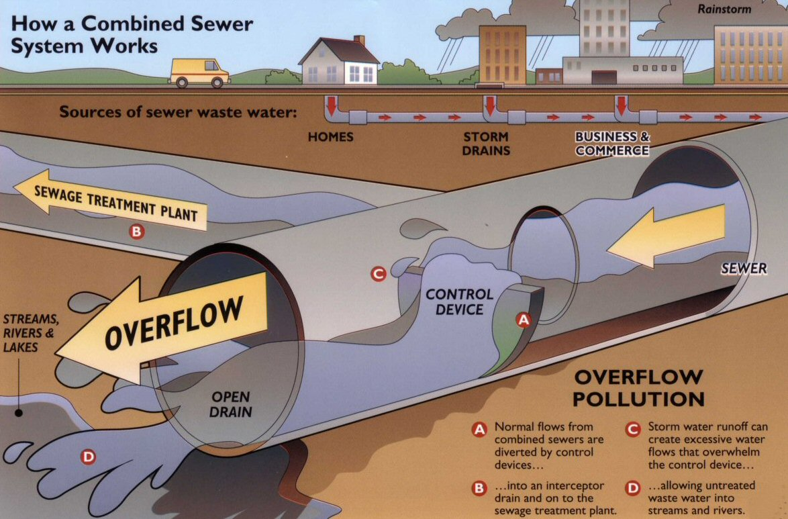
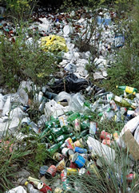
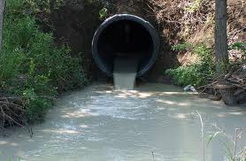
Grey Stormwater Infrastructure
Culvert pipes, outlets and combine sewer overflows
Notes:
How is water treated in the grey infrastructure system? After the water enters the storm drains (carrying trash , debris, oils, chemicals and everything else) it enters into a system of pipes and culverts under our roads. These pipes typically drain directly into our streams through outfalls.
What is a combined sewer system and what happens when it overflows? In older systems, storm water pipes underground are combined with sewage water pipes coming from our buildings. During dry weather, the pipes carry only the sewage which is diverted to a wastewater treatment plant. During rain events, however, those same pipes also will carry large volumes of storm water. These systems were designed only to carry a certain volume of water, and when that water level is exceeded, the additional water (combined sewage and storm water) overflows directly into the stream. We call these systems combined sewer overflow (CSO) systems.
Cities all across the USA have been required by law to reduce or eliminate these overflows. Most cities plan to accomplish this by either temporarily storing the stormwater and then slowly releasing it into the combined sewer system (preventing an overflow) or by infiltrating the storm water into the ground to reduce the total amount of storm water entering into the combined sewer system. The City of Philadelphia has chosen to install “green storm water infrastructure” to alternatively manage their stormwater.

Slide 7
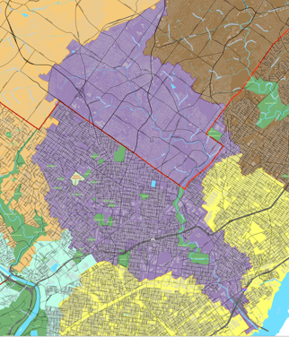
Know your watershed
Tookany, Tacony, Frankford Watershed
Notes:
The watershed pictured is the Tookany, Tacony, Frankford watershed, encompassing the land areas that flow into those three streams. Much of this watershed is located in Philadelphia, draining water from a very urbanized area.
Urban runoff drains directly into the stream via the infrastructure underneath the roads and sidewalks of the city.
We call this system composed of impervious surfaces, storm drains, pipes and outlets “GREY Infrastructure”.

Slide 8
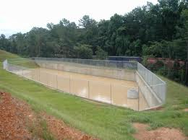
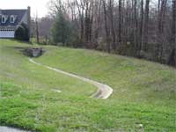
Managing Stormwater
Conventional Practice- Dry Detention Basin
Notes:
Conventional stormwater management practices and their main purpose:
Starting in the 1970’s, storm water management systems were designed to manage flooding caused by the hard constructed surfaces of development. These systems were not designed to reduce the total volume of water entering the stream, but to temporarily retain the water and then slowly release it to the stream during a flooding event.
These conventional systems are of two types: Dry and Wet. Dry basins are dry except during large rain events, when they fill up with water and slowly release it into the stream. Wet basins are continually filled with water, slowly releasing excess water into the stream during a rain event.

Slide 9
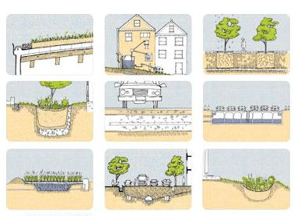
Green Stormwater Infrastructure
Stormwater management integrated into the landscape
Notes:
“Green Stormwater Infrastructure” (or GSI) is the term used to describe storm water management options that reduce the storm water volume using natural systems, including plants, soils and microbial organisms. These infrastructure systems are designed to retain stormwater, reduce the total volume of water, and recharge groundwater. They are designed to manage small rain events that make up the majority of rain events that occur. In Pennsylvania, around 90% of the annual precipitation happens during small rain events.

Slide 10
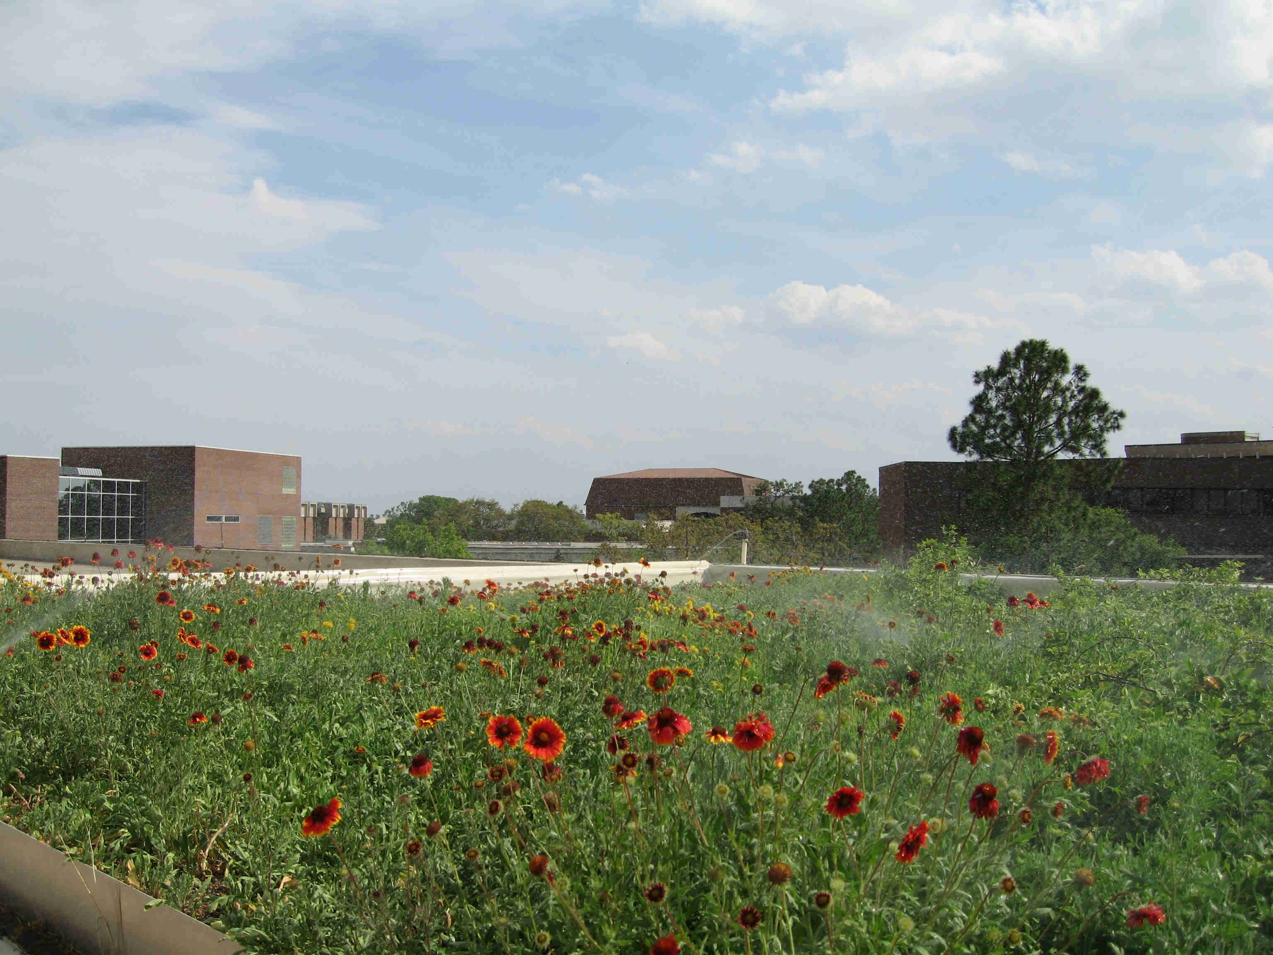
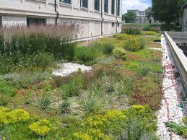
GSI- dry systems
Green Roof
Notes:
There are also two classes of green stormwater infrastructure systems: Dry and Wet.
Dry systems only hold water for a short period of time after a storm event. They are designed to drain quickly, either through infiltration into the soil or through evapo-transpiration. Examples of dry systems include greenroofs, bio-retention basins and porous pavement.
Greenroofs depend mostly on evapo-transpiration to remove the rain water from the system.

Slide 11
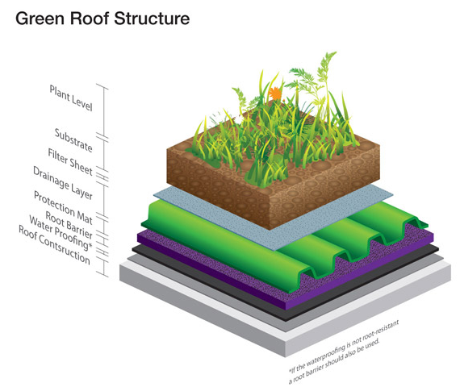
Green roof cross section
Notes:
Greenroof components include: drought tolerant plants, lightweight planting media, a filter strip holding the planting media in place, a drainage layer to allow excess water to be removed from the system, and a water proof barrier to prevent water from leaking through the roof.

Slide 12
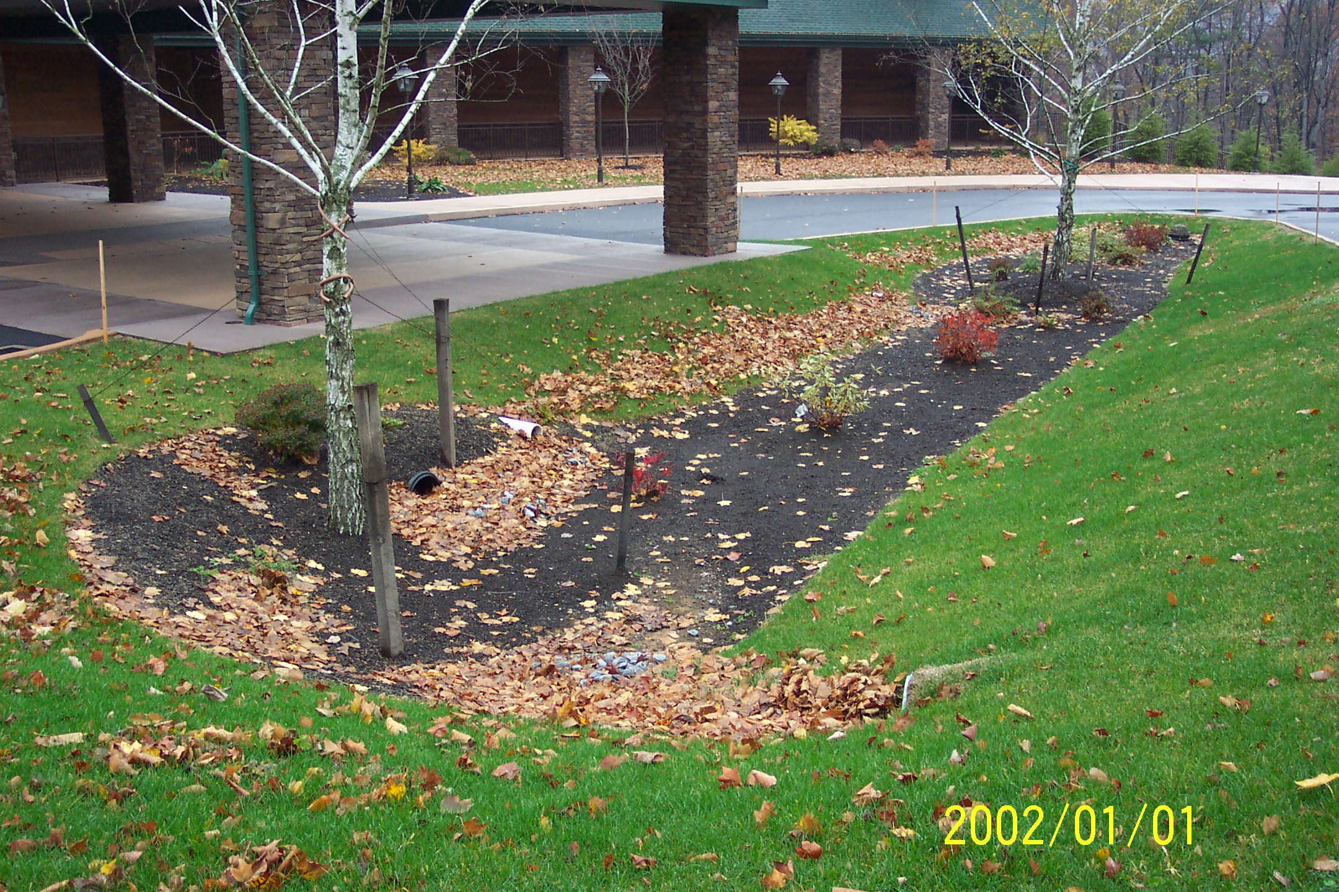
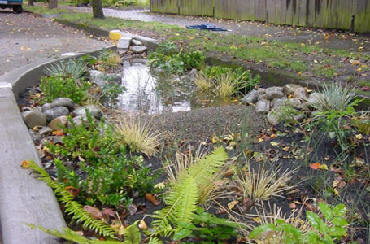
GSI- Dry System
Bio-Retention
Notes:
A bio-retention system depends on infiltration to remove water from the system. Porous soils will soak any ponding water into the soil and thus recharge the ground water.

Slide 13
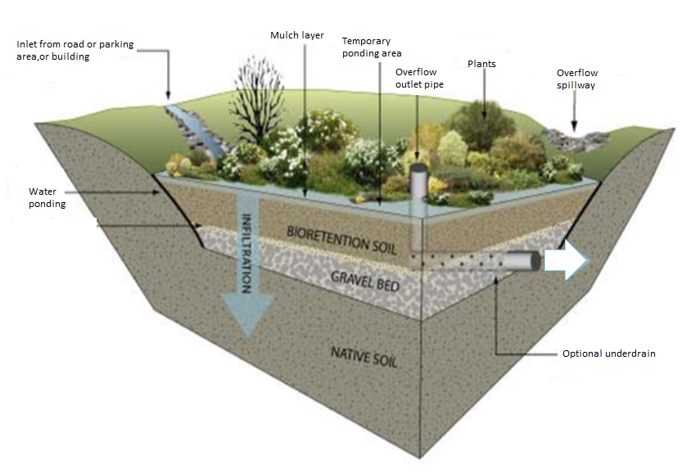
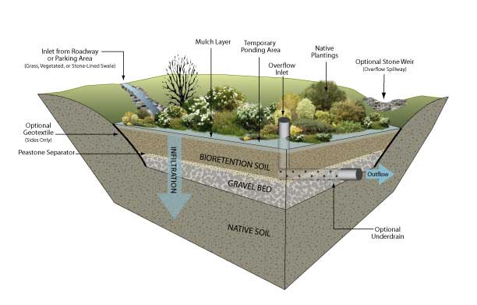
Bio-retention cross-section
Notes:
The bio-retention system includes plants that can tolerate both wet and dry soil conditions, well-draining soils, a recessed planting bed, an inlet to allow water into the system, and outlet to allow excess water out of the system.

Slide 14
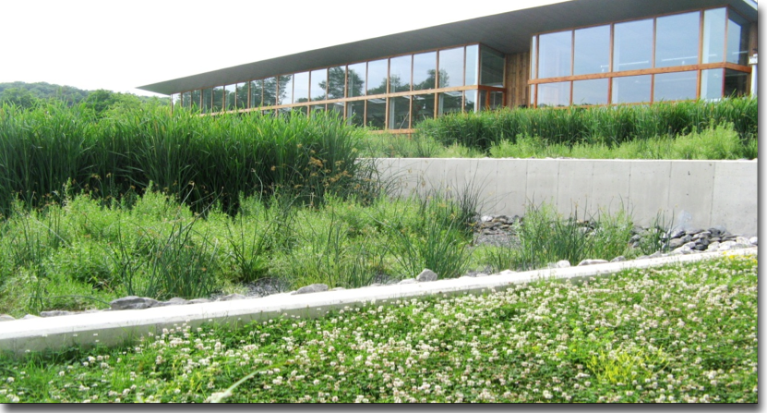
GSI- wet systems
Constructed Wetlands
Notes:
Wet systems are the second type of Green Stormwater Infrastructure system, including constructed wetlands and naturalized storm water basins. These hold water within the systems for longer periods of time, so they can support wetland plants that withstand oxygen-depleted soils, and a suite of soil microbes that can survive in soils that lack oxygen. Wet systems depend on evapo-transpiration and limited infiltration to remove stormwater from the system. The soils in these systems do not drain well, and water will pond for longer periods of time in the planting bed.
This completes our overview of common storm water management systems.

Slide 15
THANK YOU TO OUR
FUNDER & PARTNERS
Notes:
These training modules were funded by the United States Environmental Protection Agency. Partners involved in the program include: Pennsylvania Horticultural Society; Tookany, Tacony, Frankford Watershed Association; GreenTreks Network, Inc.; Philadelphia Parks and Recreation, and the US Forest Service Northeast Field Station.

Slide 16
Next up……………….
Components of Bio-retention System
Notes:
The next module in the series will discuss the actual components of a typical bio-retention system.
Thank you for participating!

